Slide 1
MUSHROOM CLASSIFICATION DETAILED PROJECT REPORT (DPR)
AUTHOR : AKSHAY PANDURANG PAUNIKAR

Slide 2
ABSTRACT
Mushrooms have been consumed since earliest history. The word Mushroom is derived from the French word for Fungi and Mold. Now-a-days, Mushroom are popular valuable food because they are low in calories, carbohydrate, Fat, sodium and also cholesterol free. Besides this, Mushroom provides important nutrients, including selenium, potassium, riboflavin, niacin, Vitamin D, proteins and fiber. All together with a long history as food source. Mushroom are important for their healing capacity and properties in traditional medicine. It has reported beneficial effects for health and treatment of some disease. Many nutraceutical properties are described in Mushroom like cancer and antitumor attributes. Mushroom act as antibacterial, immune system enhancer and cholesterol lowering Agent. Additionally, they are important source of bio-active compounds. This work is a machine learning model that classifies mushrooms into 2 classes: Poisonous and Edible depending on the features of the mushroom. During this machine learning implementation, we are going to see which features are important to predict whether a mushroom is poisonous or edible.

Slide 3
INTRODUCTION
Purpose of Detailed Project Report (DPR)
A detailed project report is a very extensive and elaborative outline of a project, which includes essential information such as the resources and tasks to be carried out in order to make the project turn into a success. It can also be said that it is the final blueprint of a project after which the implementation and operational process can occur.
In this comprehensive project report, we will discuss about the end to end implementation of Mushroom Classification with necessary details like Architecture, Data Visualization, Data Preprocessing, Model Building, Model Performance and Deployment of this project with sample test cases.

Slide 4
Problem Statement
The Audubon Society Field Guide to North American Mushrooms contains descriptions of hypothetical samples corresponding to 23 species of gilled mushrooms in the Agaricus and Lepiota Family Mushroom (1981). Each species is labelled as either definitely edible, definitely poisonous, or maybe edible but not recommended. This last category was merged with the toxic category. The Guide asserts unequivocally that there is no simple rule for judging a mushroom's edibility, such as "leaflets three, leave it be" for Poisonous Oak and Ivy.
The main goal is to predict which mushroom is poisonous & which is edible.

Slide 5
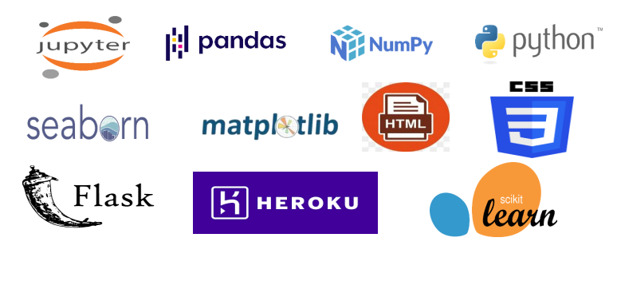
Tools Used

Slide 6
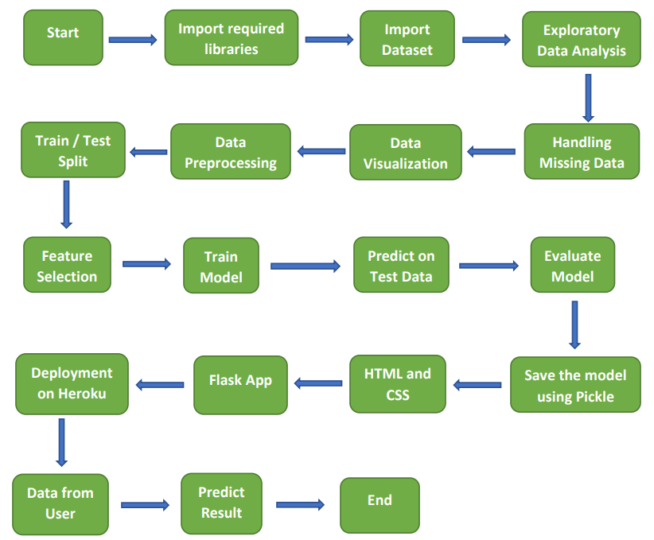
Architecture Design

Slide 7
Architecture Description
Data Collection
The data for this project is collected from the Kaggle Dataset, the URL for the dataset is given below: https://www.kaggle.com/datasets/uciml/mushroom-classification.
Data Description
This dataset includes descriptions of hypothetical samples corresponding to 23 species of gilled mushrooms in the Agaricus and Lepiota Family Mushroom drawn from The Audubon Society Field Guide to North American Mushrooms (1981). Each species is identified as definitely edible, definitely poisonous, or of unknown edibility and not recommended. This latter class was combined with the poisonous one.
Exploratory Data Analysis
There are 8124 rows and 23 columns in this data. All the columns are of categorical type. There are two classes present in our target column which are 'p' - poisonous and 'e' - edible.
Handling Missing Data
At first, we observed that there no missing/null values in the dataset. However, if you go through the data description (check the link) you will find that the missing values in one column is replaced with "?". There are 2480 missing values in 'stalk-root' column. First, we will replace these values with np.nan so that we can handle missing data. we will impute the missing values in 'stalk-root' column using sklearn SimpleImputer with strategy='most_frequent'.

Slide 8
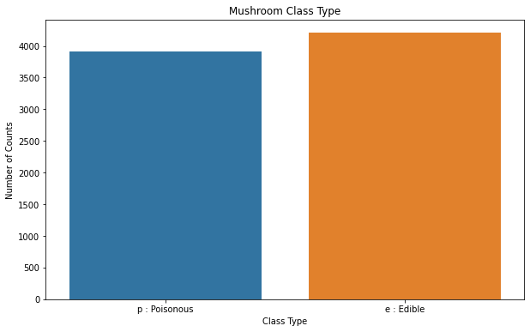
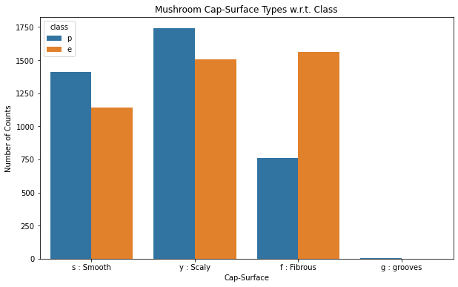
Data Visualization
Mushroom Class Type
Mushroom Cap Surface

Slide 9
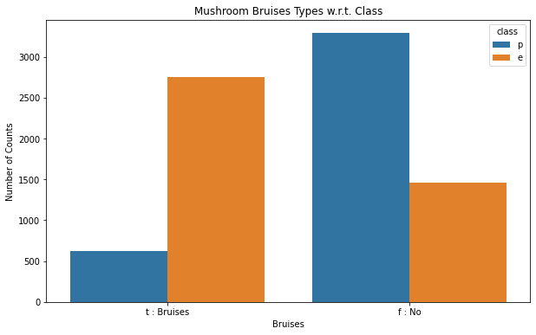
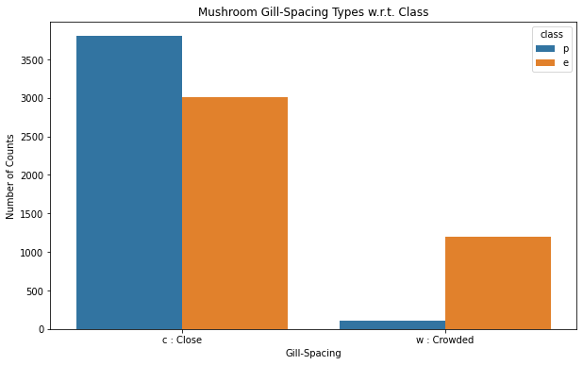
Data Visualization (continued..)
Mushroom Bruises Types
Mushroom Gill Spacing

Slide 10
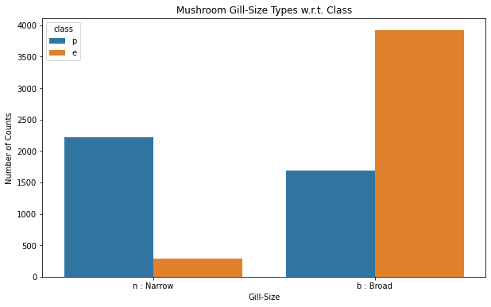
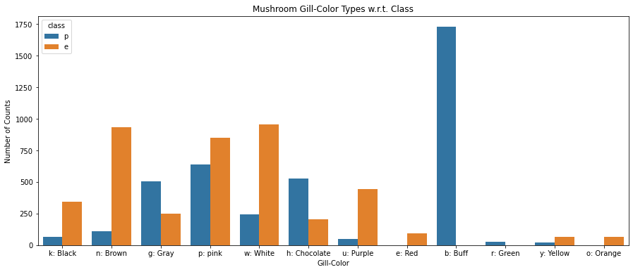
Data Visualization (continued..)
Mushroom Gill Size
Mushroom Gill Color

Slide 11
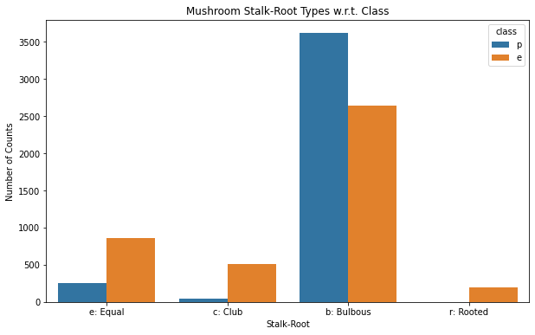
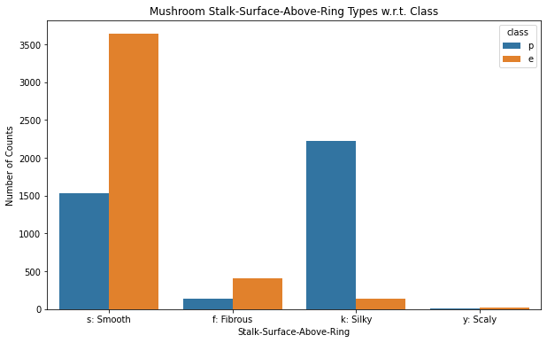
Data Visualization (continued..)
Mushroom Stalk Root
Stalk Surface Above Ring

Slide 12
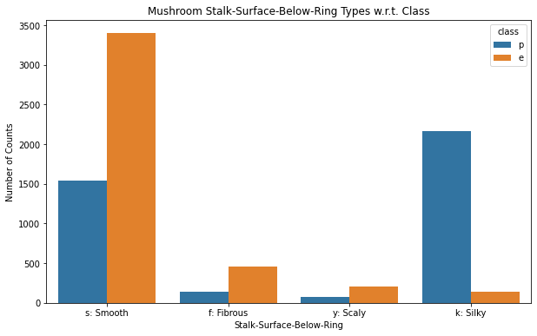
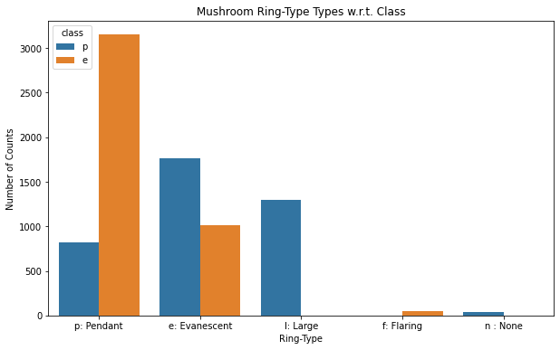
Data Visualization (continued..)
Stalk Surface Below Ring
Mushroom Ring Type

Slide 13
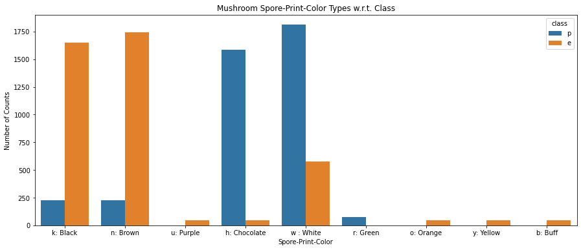
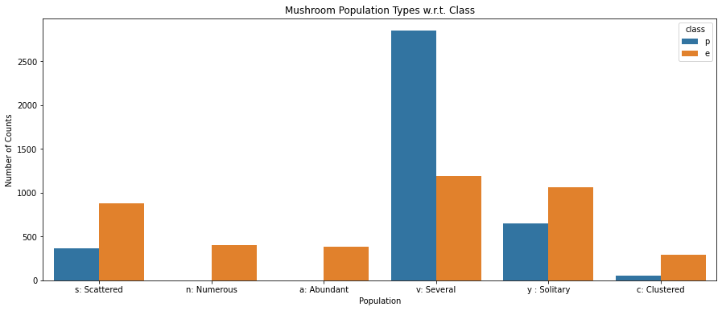
Data Visualization (continued..)
Spore Print Color
Population

Slide 14
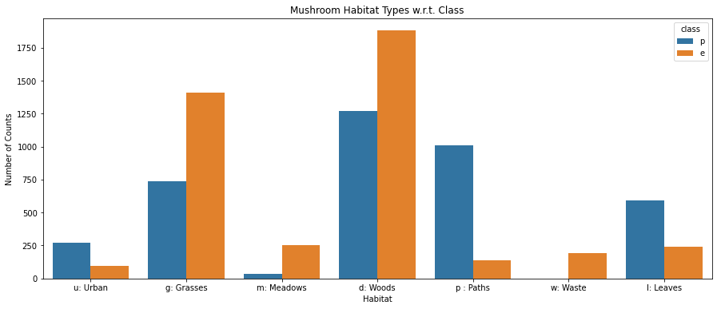
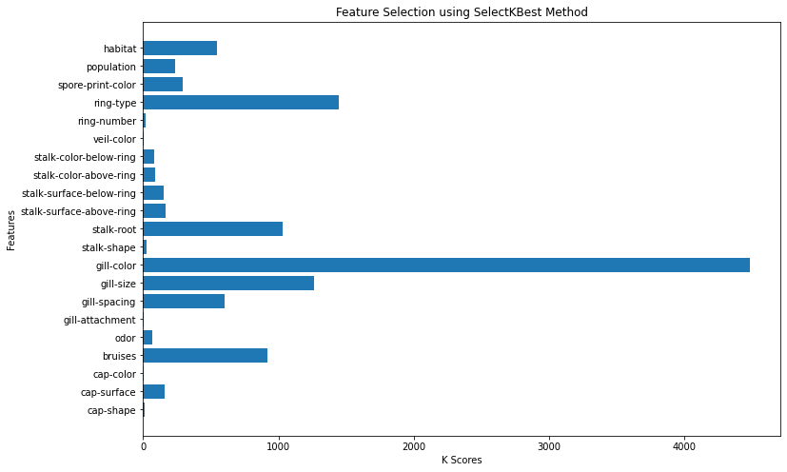
Data Visualization (continued..)
Habitat
Feature Selection

Slide 15
Architecture Description (continued..)
Data Preprocessing
In this step, first we have dropped the column 'veil-type' as it has only one value throughout the data. So, it won't give us much information regarding the class of the mushroom. Next, we mapped our target column to 0 (poisonous) & 1 (edible) values. We used Label Encoder to convert categorical values to numerical then we scaled our data to bring them to same class.
Feature Selection
After splitting the data into train and test set, we used SelectKBest method with score_func=chi2 to find out which features are most relevant to target column and we found that there are 12 columns out of 21 which we needed for training our model.
Model Training & Evaluation
We used XGBClassifier as a model for model training it was very fast compared to the other models and it produced 100% accuracy on train data as well as on test data which is a very good for our project.
Model Deployment
We created a webpage using HTML and CSS. We created a Flask web app and first tested in on our local machine. Then we deployed our model using Heroku. We used different combination of input and predicted the output and the results were accurate. The app was working fine and there were no issues found

Slide 16
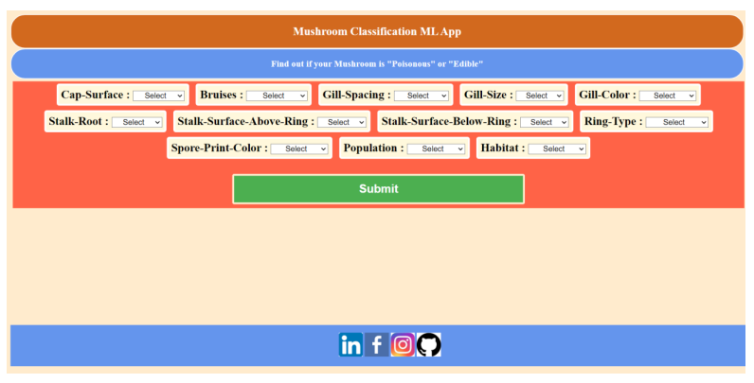
Web Interface
App Link : https://mushroom-classification-ml-api.herokuapp.com/

Slide 17
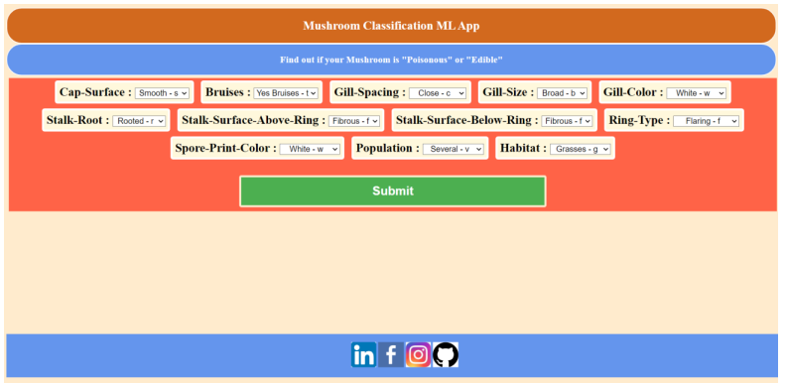
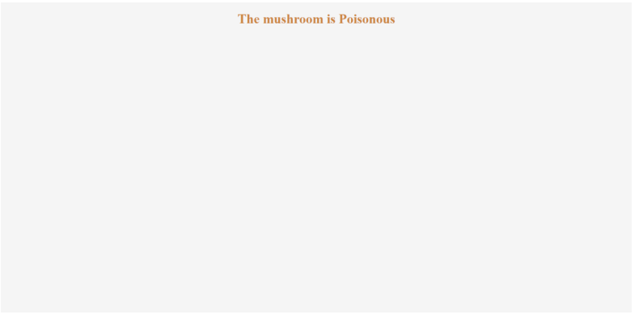
Test Cases
Poisonous Mushroom
Predicted Output

Slide 18
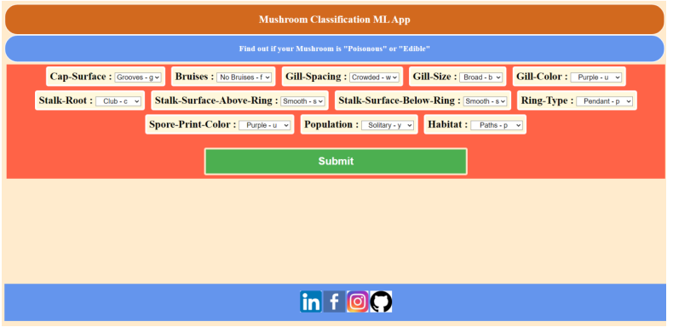
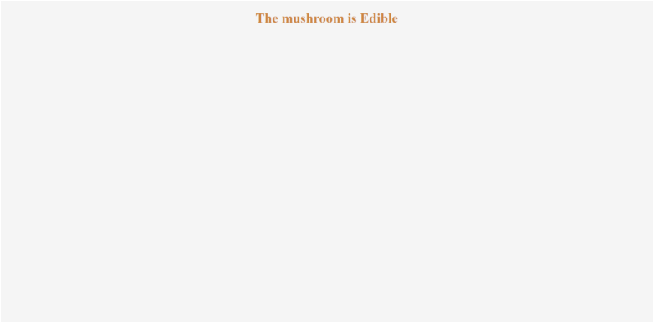
Test Cases (continued)
Edible Mushroom
Predicted Output

Slide 19
Summary
The target column has 2 class type one is 'poisonous' which has 3916 counts and second is 'edible' which has 4208 counts so we have nearly equal counts for poisonous and edible classes in our data. Hence we can say that our data is balanced.
There are 4 types of cap-surface in a mushroom and also it suggests that 'edible' mushrooms do not have 'cap-surface' : 'g : grooves' according to our data.
The mushroom may or may not have bruises but still it could be poisonous or edible according to our data.
The mushroom can have Gill Spacing as Close or Crowded but still it could be poisonous or edible according to our data.
The mushroom can have Gill Size as Narrow or Broad but still it could be poisonous or edible according to our data.
The 'edible' mushroom do not have Gill Color : Buff, Green and 'poisonous' mushroom do not have Gill Color : Red, Orange according to our data.
The 'poisonous' mushroom do not have Stalk Root as Rooted type according to our data.
The mushroom can have Stalk-Surface-Above-Ring as Smooth, Fibrous, Silky or Scaly but still it could be poisonous or edible according to our data.
The mushroom can have Stalk-Surface-Below-Ring as Smooth, Fibrous, Silky or Scaly but still it could be poisonous or edible according to our data.
The 'edible' mushroom do not have Ring-Type as Large and None and 'poisonous' mushroom do not have Ring-Type as Flaring according to our data.
The 'edible' mushrooms do not have Spore-Print-Color as Green and 'poisonous' mushrooms do not have Spore-Print-Color as Purple, Orange, Yellow, Buff according to our data.
The 'poisonous' mushrooms do not have Population Type as Numerous and Abundant according to our data.
The 'poisonous' mushrooms do not have Habitat Type as Waste according to our data.
The XGBoost Classifier model has 100% accuracy on both training data and test data.

Slide 20
Q & A
What was the type of data ?
The data was of categorical type.
What is the complete flow of this project ?
Please refer to Architecture and it’s description.
How many features were used during deployment ?
We used only 12 features out of 21 to predict our output.
Which cloud platform was used for deployment ?
Heroku was used as a cloud platform to deploy this project.
Is your model 100% sure about whether mushroom is edible or poisonous ?
Looking at the results, yes we are sure. However, it is recommended that you also take help from someone who is expert as some characteristics are same for edible and poisonous mushrooms.

